Slide 1
SVCC Pass Summit 2018 Success ˚ Student ˚ Advocating ˚ Partnership

Slide 2
The Economic State of the 71st District
Representative Tony McCombie

Slide 3
Biography: Born and raised in Savanna, IL. Received BA from Western Illinois University. Currently is a small businesswoman, operating Blue Appraisals and self-employed in the real estate industry as a broker with Mel Foster Company. Formerly served as the Mayor of Savanna, IL and as a Savanna Councilwoman. She is a citizen legislator who lives in Savanna with her husband, Curt.
Sworn in January 11, 2017 Committee assignments:
Business & Occupational Licenses
Business Incentives for Local Communities, Cities & Villages
Elementary Secondary Education: School Curriculum Policies
Tourism, Hospitality & Craft Industries
Transportation: Regulation, Roads

Slide 4
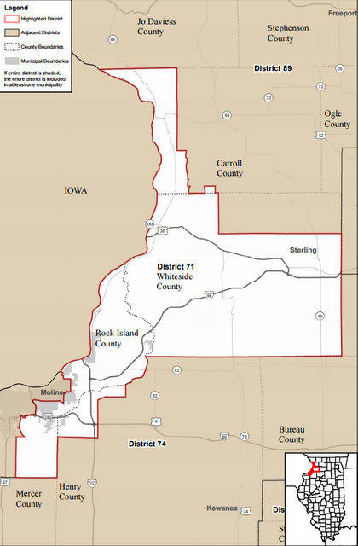

Slide 5
Opening Questions
How many of are originally from the Sauk Valley area?
How many of you returned to the Sauk Valley area?
Have your children stayed in IL for post secondary education/training?
Have your children pursued in the Sauk Valley Region and/or Illinois?
How many of you believe there are no job opportunities in the Sauk Valley area?
Let's use CGH as an example. How many jobs do you think are available at CGH right now?
What are some important skills employers are looking for?
What type of jobs do you think are in demand?

Slide 6
Illinois
Population
Today….12.77 million
2015…12.86 million
2010…12.84 million
Why do people leave?
School / Employment
Taxes / Regulations
Weather / Retirement

Slide 7
Illinois / Sauk Valley
Top Five Categories of Employment Sectors
Health Care
Technology
Education
Transportation/Distribution/Logistics
Manufacturing – Skilled
Unemployment Rate
US – Oct 2017 – 4.1%
State – Oct 2017 - 4.9%
Unemployment Rate on Oct 2017: 4.2% in Carroll, 4.6% in Rock Island and 4.4% in Whiteside

Slide 8
Economics of District 71
Agriculture, Manufacturing, Distribution and Small Business (Service, Retail, Food & Beverage)
Major employers are Walmart, Wahl Clipper, Exelon, John Deere, our School Districts
Transportation (Road, Rail, Water & Air)
Tourism (Trails, Parks, Rivers, Events)

Slide 9
Sauk Valley Challenges
State of Illinois Budget Issues
Spending more than we are taking in
Debt Backlog and Pension Debt
Out migration due to work, property taxes, & retirement
Cost of secondary and higher education
Political and Structural Policies
Cuts to line items that bring revenue
Incentives, Marketing Illinois, Projects
Skills Gap / Health Care Worker & Teacher Shortages
Proximity to Iowa – Ex. schools, property taxes, workers comps

Slide 10
Mike Rowe – Skills Gap

Slide 11
Are There Jobs?
Wahl Clipper
20-25 assembly floor positions open – HS Education
10-12 high level positions open – 2-4 yrs higher education
Rock River Aggregate
2-4 positions in Agronomy – 4 yr – Inner personnel / math skills
CGH
46 various positions open – various levels of education
Frantz
2 inspectors with mechanical skills needed
Astec Mobile Screens
2 machine operators – HS Education
Sauk Valley Community College
28 various positions – various levels of education
Timken Drives, DuPont, 3M, John Deere, Walmart Distribution, Metlife

Slide 14
Top Issues from Employers
Skilled Labor Shortage
Attendance
Drug Test
Work Ethic

Slide 15
Sauk Valley - Positives
Community Colleges / Technology Schools
Help close the skills gap
Future Decision Building
Establish Roots
High Schools Programs to build Entrepreneurs / Skilled Labor
WACC / Vocational Programs
Ag Programs
CEO Program / Entrepreneurial Programs
Diverse Ag Education & Industry
Quality of Life (Health Care, Housing, Recreation, Proximity to Culture)
Safe Place to Raise a Family
Major Business Partners: Wahl Clipper, Exelon; John Deere, Etc
Proximity to Transportation Corridors

Slide 16
Initiatives to Build our Future
Provide “shovel ready” opportunities for new companies to come to area.
Clean Up / Rehab “run-down” areas and improve areas like the riverfront to add appeal to the area.
Good Schools with class choices, variety, amenities when moving to the area.
Strong Chambers and Service Clubs to help those less fortunate
Attempt to bring jobs to the area that are attractive to young people, like software programming, marketing firms, etc

Slide 17
Initiatives to Build our Future
More programs/partnering with local businesses/community colleges to grow/continue a pipeline to close the skills gap for open and developing positions
Diversify with non for profit / health sector business
Capital Bill
Mississippi Bicentennial Restoration tax credit bill (Halpin/McCombie)
Political / Structural Reforms

Slide 18
District 71 - QCA

Slide 19
Closing Questions
How many of you believe there are good job opportunities in District 71?
Do you believe there are a variety of jobs in District 71?
How do you engage our youth to believe attendance, loyalty and dedication are important attributes?
Are you able to provide challenges in the work place to encourage longevity, advanced learning/skills, etc
What are you doing to attract candidates to come to the Sauk Valley area and join your team?
Does your workplace offer an internship, apprenticeship, or on-the-job training program to fill your employment gaps?

Slide 20
Thank You!
Please follow me on Social Media at:
Tony McCombie or McCombie for Illi
Visit my website at:
www.repmccombie.com
Or email me at:
mccombie@ilhousegop.com

